Slide 2
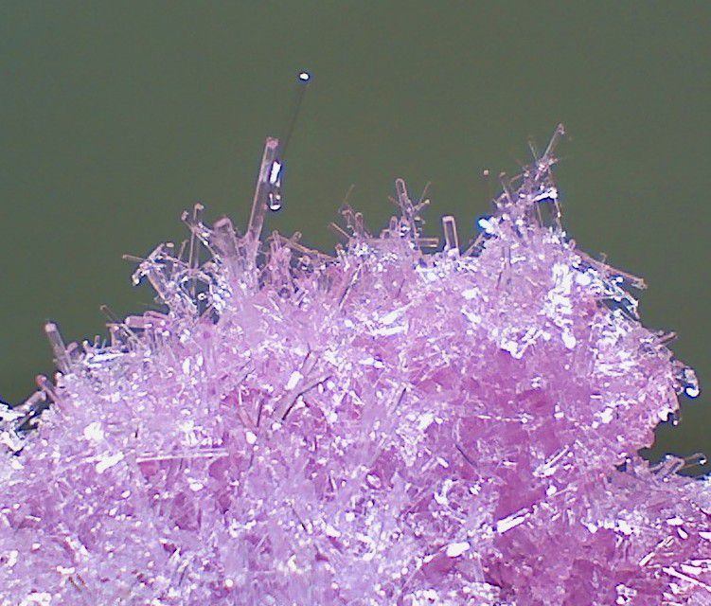
Crystal: solids where the particles are organized in an orderly repeating pattern

Slide 3
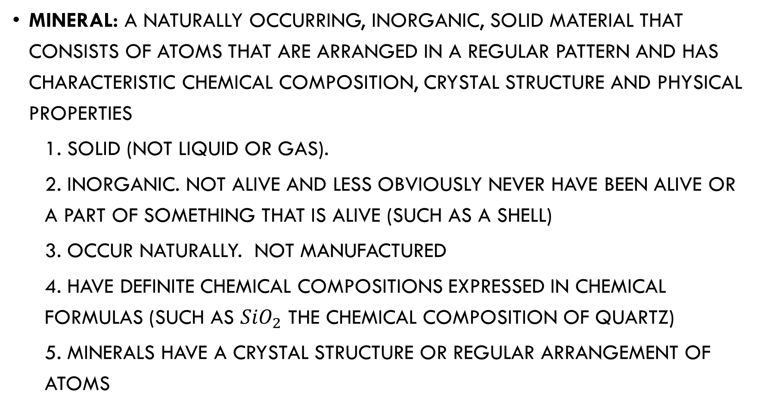
Mineral: a naturally occurring, inorganic, solid material that consists of atoms that are arranged in a regular pattern and has characteristic chemical composition, crystal structure and physical properties
  1. solid (not liquid or gas).
  2. inorganic. not alive and less obviously never have been Alive or a part of something that is alive (such as a shell)
  3. occur naturally. not Manufactured
  4. Have definite chemical compositions expressed in chemical formulas (such as ${SiO}_{2}$ the chemical composition of quartz)
  5. Minerals have a crystal structure or regular arrangement of atoms

Slide 4
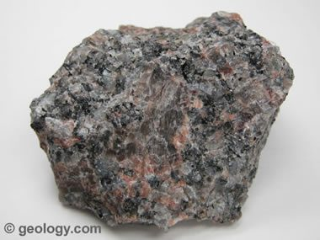
Rocks: naturally occurring collections of mineral grains

Slide 5
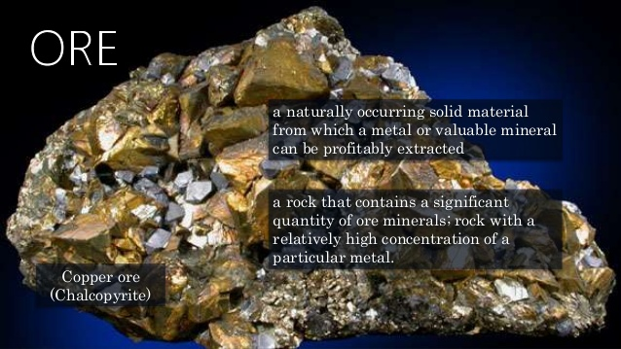
Ores: Rocks that contain valuable minerals

Slide 6
There are several measures used to describe, compare and identify minerals
Color
Hardness
Luster
Streak
Attraction to a magnet
Cleavage
Specific gravity
Crystal shape
Electrical conductivity
Reaction to acid
Radioactivity
Fluorescence
Generally one of these tests cannot offer a definitive identification, but must be used in concert

Slide 7
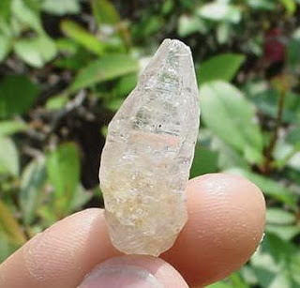
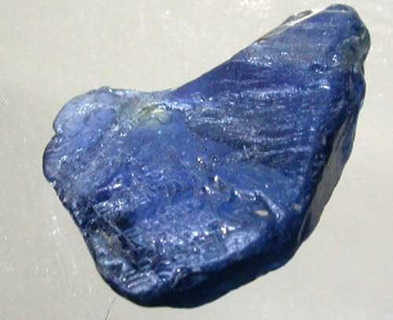
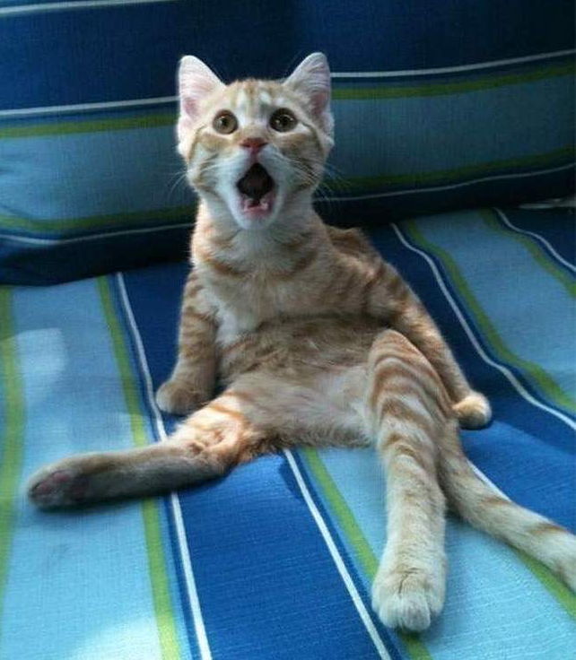
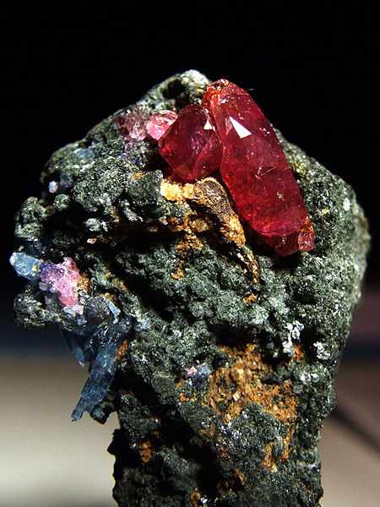
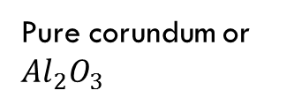
1. color can be one of the most salient features of a rock, it is also frequently one of the most deceptive features of a rock.
  Color is often a result of impurities rather than the nature of the rock
Wow! That’s purdy!
If corundum contains a fraction of Al3+ ions substituted for Cr3+, it will produce ruby:
Corundum contaminated with titanium is a sapphire
Pure corundum or ${Al}_{2}O_{3}$

Slide 8
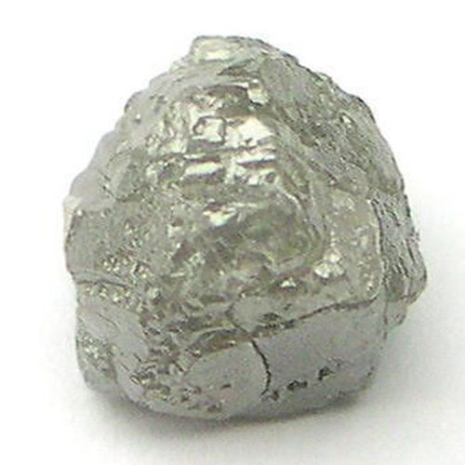
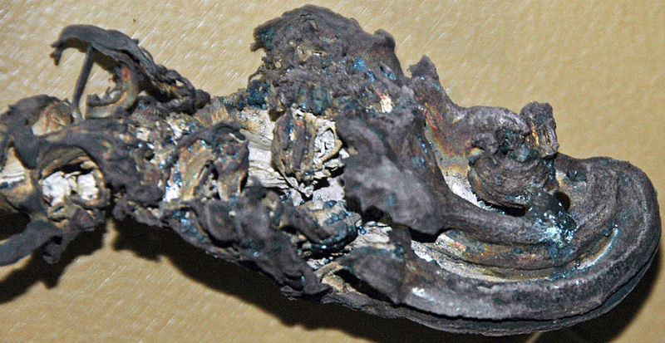
Some minerals can tarnish or change when exposed to air which also makes them look different
Natural silver before and after being tarnished

Slide 9
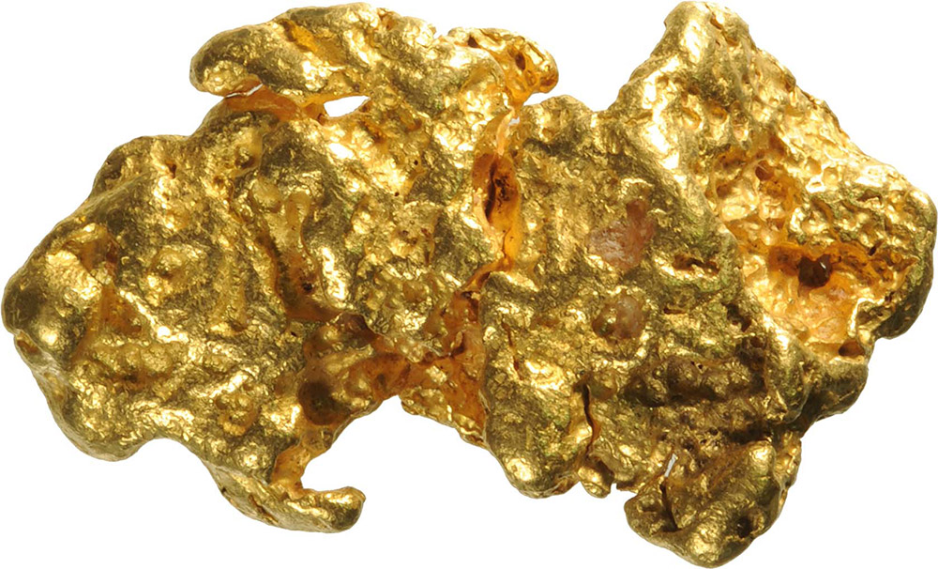
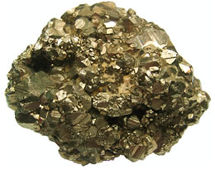

Many rocks have indistinguishable colors that have to be determined using other tests
Fool’s gold or iron pirate vs. actual gold
Dang nab it! That’s iron pirate! I’m a fool!

Slide 10
2. Hardness: The resistance of a mineral to scratching
Hardness is measured on the Mohs Scale of Hardness. It does not have direct measurements or units, but is in relation to other rocks

Slide 11
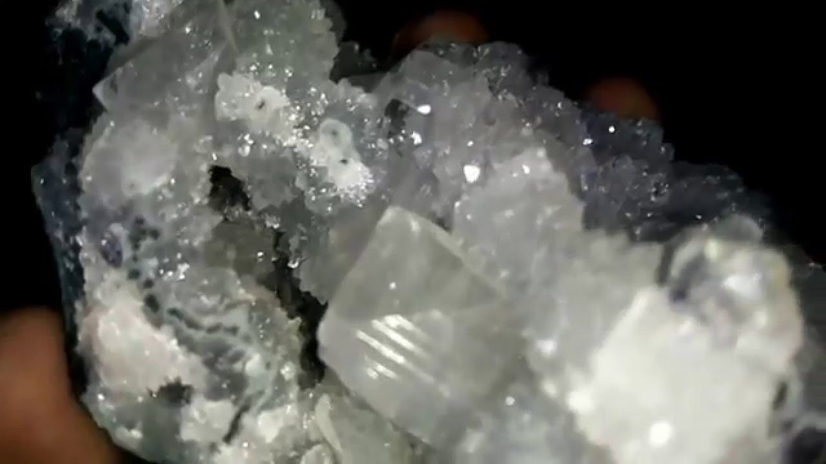
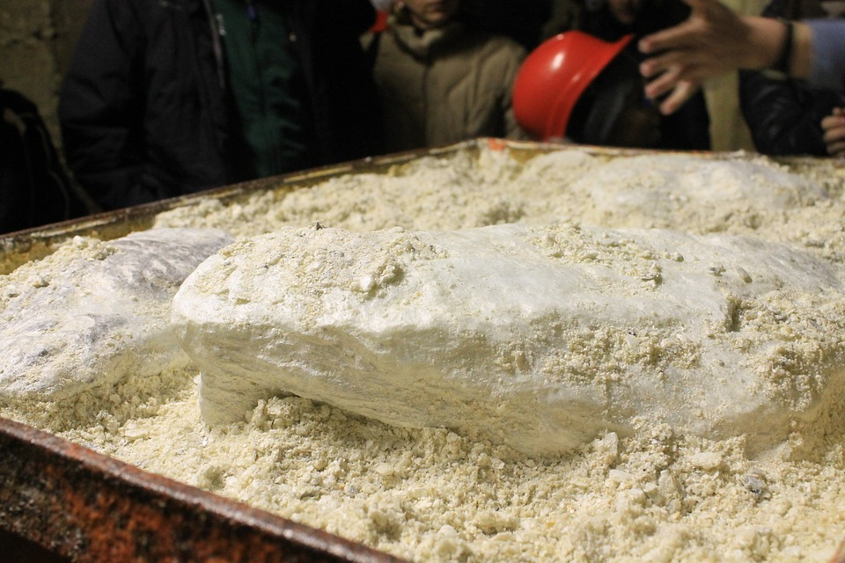

The list of Mohs scale minerals
Talc
Gypsum
Calcite
Fluorite
Apatite
Orthoclase
Quartz
Topaz
Corundum
Diamond
A mineral with a greater hardness will scratch all before it and minerals with a lower hardness will be scratched by those above it. Thus, talc is one of the softest minerals and diamonds will scratch all other rocks
Talc and diamonds in their natural form
Cool! I know what those are!!

Slide 12
3. Luster: The way a mineral reflects light
  Luster is either metallic (shiny) or non-metallic
  You can see how this simple distinction would not by itself be enough to identify a rock
  There are several different types of non-metallic luster: glassy (or vitreous), waxy, pearly, earthy or dull
  Please scroll down to look at the transcipt of the video for examples of luster. It won't let you look at the whole video unless you pay even though it is a really good one!

Slide 13
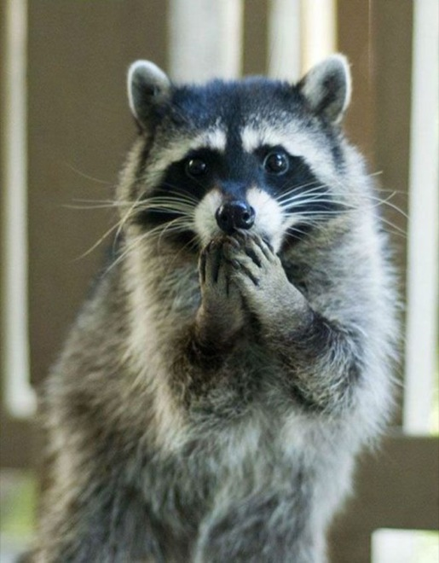
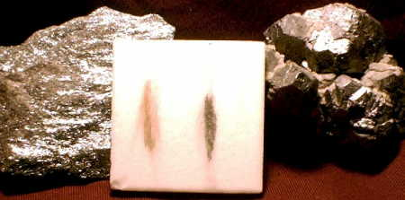
4. Streak: the color of the powdered mineral (or mineral after it has been turned into powder)
  Streak is determined by scratching it across a piece of unglazed porcelain tile (a streak plate)
  Streaks are often different colors than the mineral
  Often minerals do not leave streaks or are harder than the streak plate
Hematite’s streak is usually much redder as indicated by its name!
A streak plate that has been streaked by galena and hematite

Slide 14
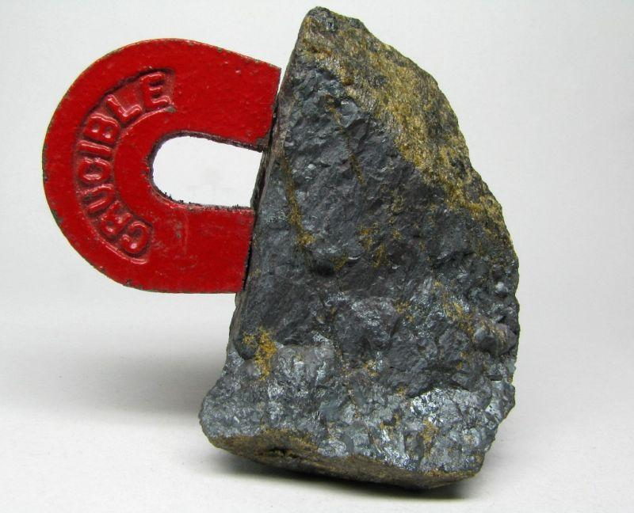

5. Attraction to a Magnet: minerals are either drawn to a magnet or they are not
  Typically metals are drawn to a magnet
Magnetite, an ore of iron, is drawn to magnets
I feel like I have heard of that mineral before!

Slide 15
6. Cleavage: Planes of atomic weakness along which rocks will consistently break to form specific shapes
  The following is a video about cleavage narrated by a knowledgeable individual who does not speak with a great deal of enthusiasm:
  video on mineral cleavage: I wanted you to see the cleavage because it is difficult to visualize without seeing it.

Slide 16
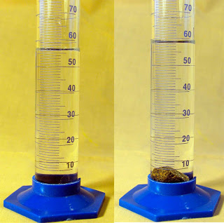

7. Specific Gravity: a ratio of the weight of the mineral to the weight of an equal volume of water
  Water has a specific gravity of 1. Anything with a specific gravity greater than 1 will sink in water
  minerals.net description of specific gravity and how to use it in identifying rocks
What does that picture mean?? I better read this article!

Slide 17
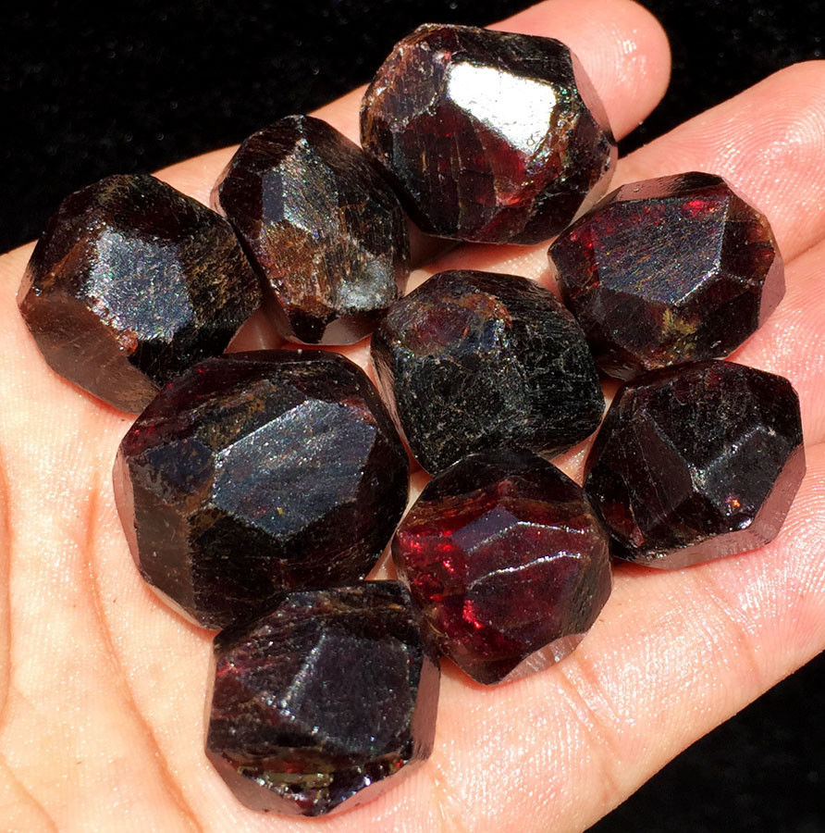
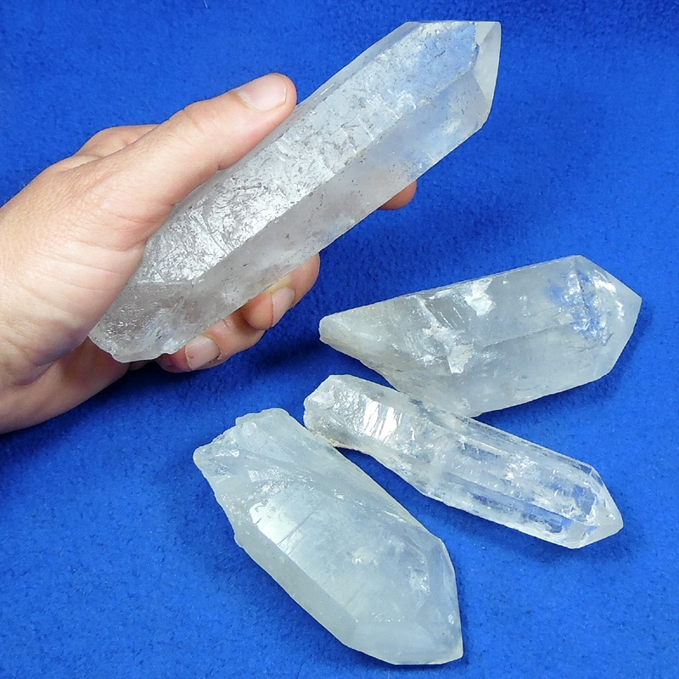

8. Crystal shape: When minerals grow in unconfined spaces, they usually have a regular crystal shape
Garnet crystals grow as dodecahedral shapes
Quartz crystals grow as 6-sided columns with pointed tops
That’s Ms. Smyser’s birthstone. Now I know what to get her for her birthday!

Slide 18
9. Electrical Conductivity: The ability to have electricity flow through the mineral with little resistance

Slide 19
10. Reaction to Acid: minerals May have chemical reactions when acids are dripped on them
  The chemical bonds in the carbonate of carbonate minerals and fizzing results as gas is released
  weak hydrochloric acid being dropped on a carbonate
  article on how to use the "reaction to acids" test on carbonate rocks

Slide 20
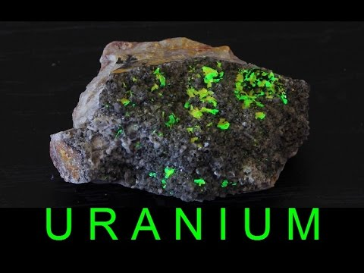

11. Radioactivity: the atoms of a few minerals are not stable and release subatomic particles in the form of radioactivity
That’s so hot, it’s radioactive!!

Slide 21
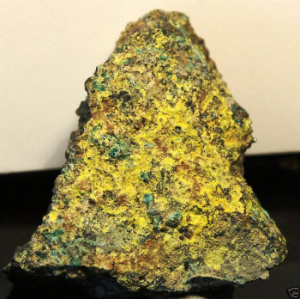
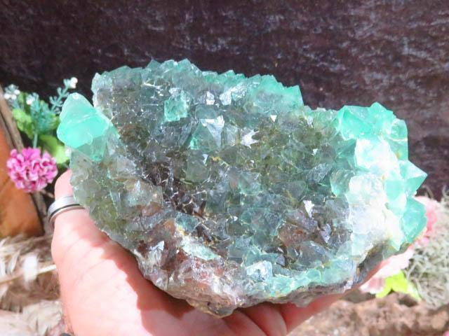
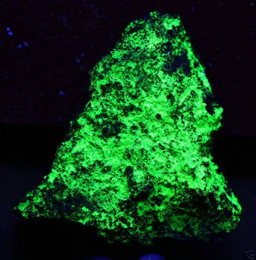
12. Fluorescence: A few minerals change ultraviolet light to other wavelengths and therefore fluoresce
  A few minerals can also be phosphorescent: They store light energy and slowly release it.
Phurcalite in the day and phurcalite at night
Fluorite fluoresces

Slide 22
Metals typically:
Conduct electricity
Are Malleable: can change shape under pressure without breaking
Ductile: Can be stretched into wire
Are magnetic

