Slide 1
The Changing Geography of Your Community
Unit 1 Section 6

Slide 2
Consider how fossils and the formation of mountains contribute to the theory of plate tectonics.

Slide 3
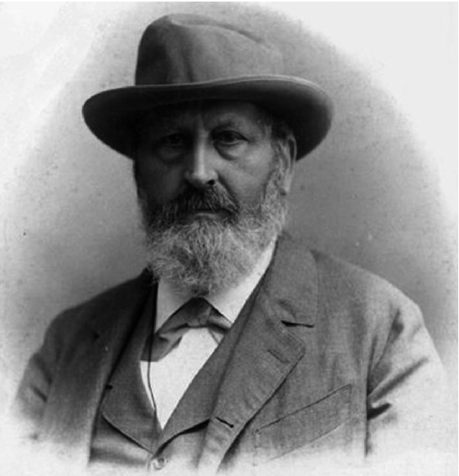

Austrian Geologist Eduard Seuss (1831-1914)
Belived that mountains and ocean basins were formed when the earth heated and cooled during its formation
Compared mountains to the wrinkles of an old apple

Slide 4

When cooling, parts of earth sank deeper than others ocean basins
Cooling caused continents and seafloor periodically rose and fell with the cooling of earth

Slide 5
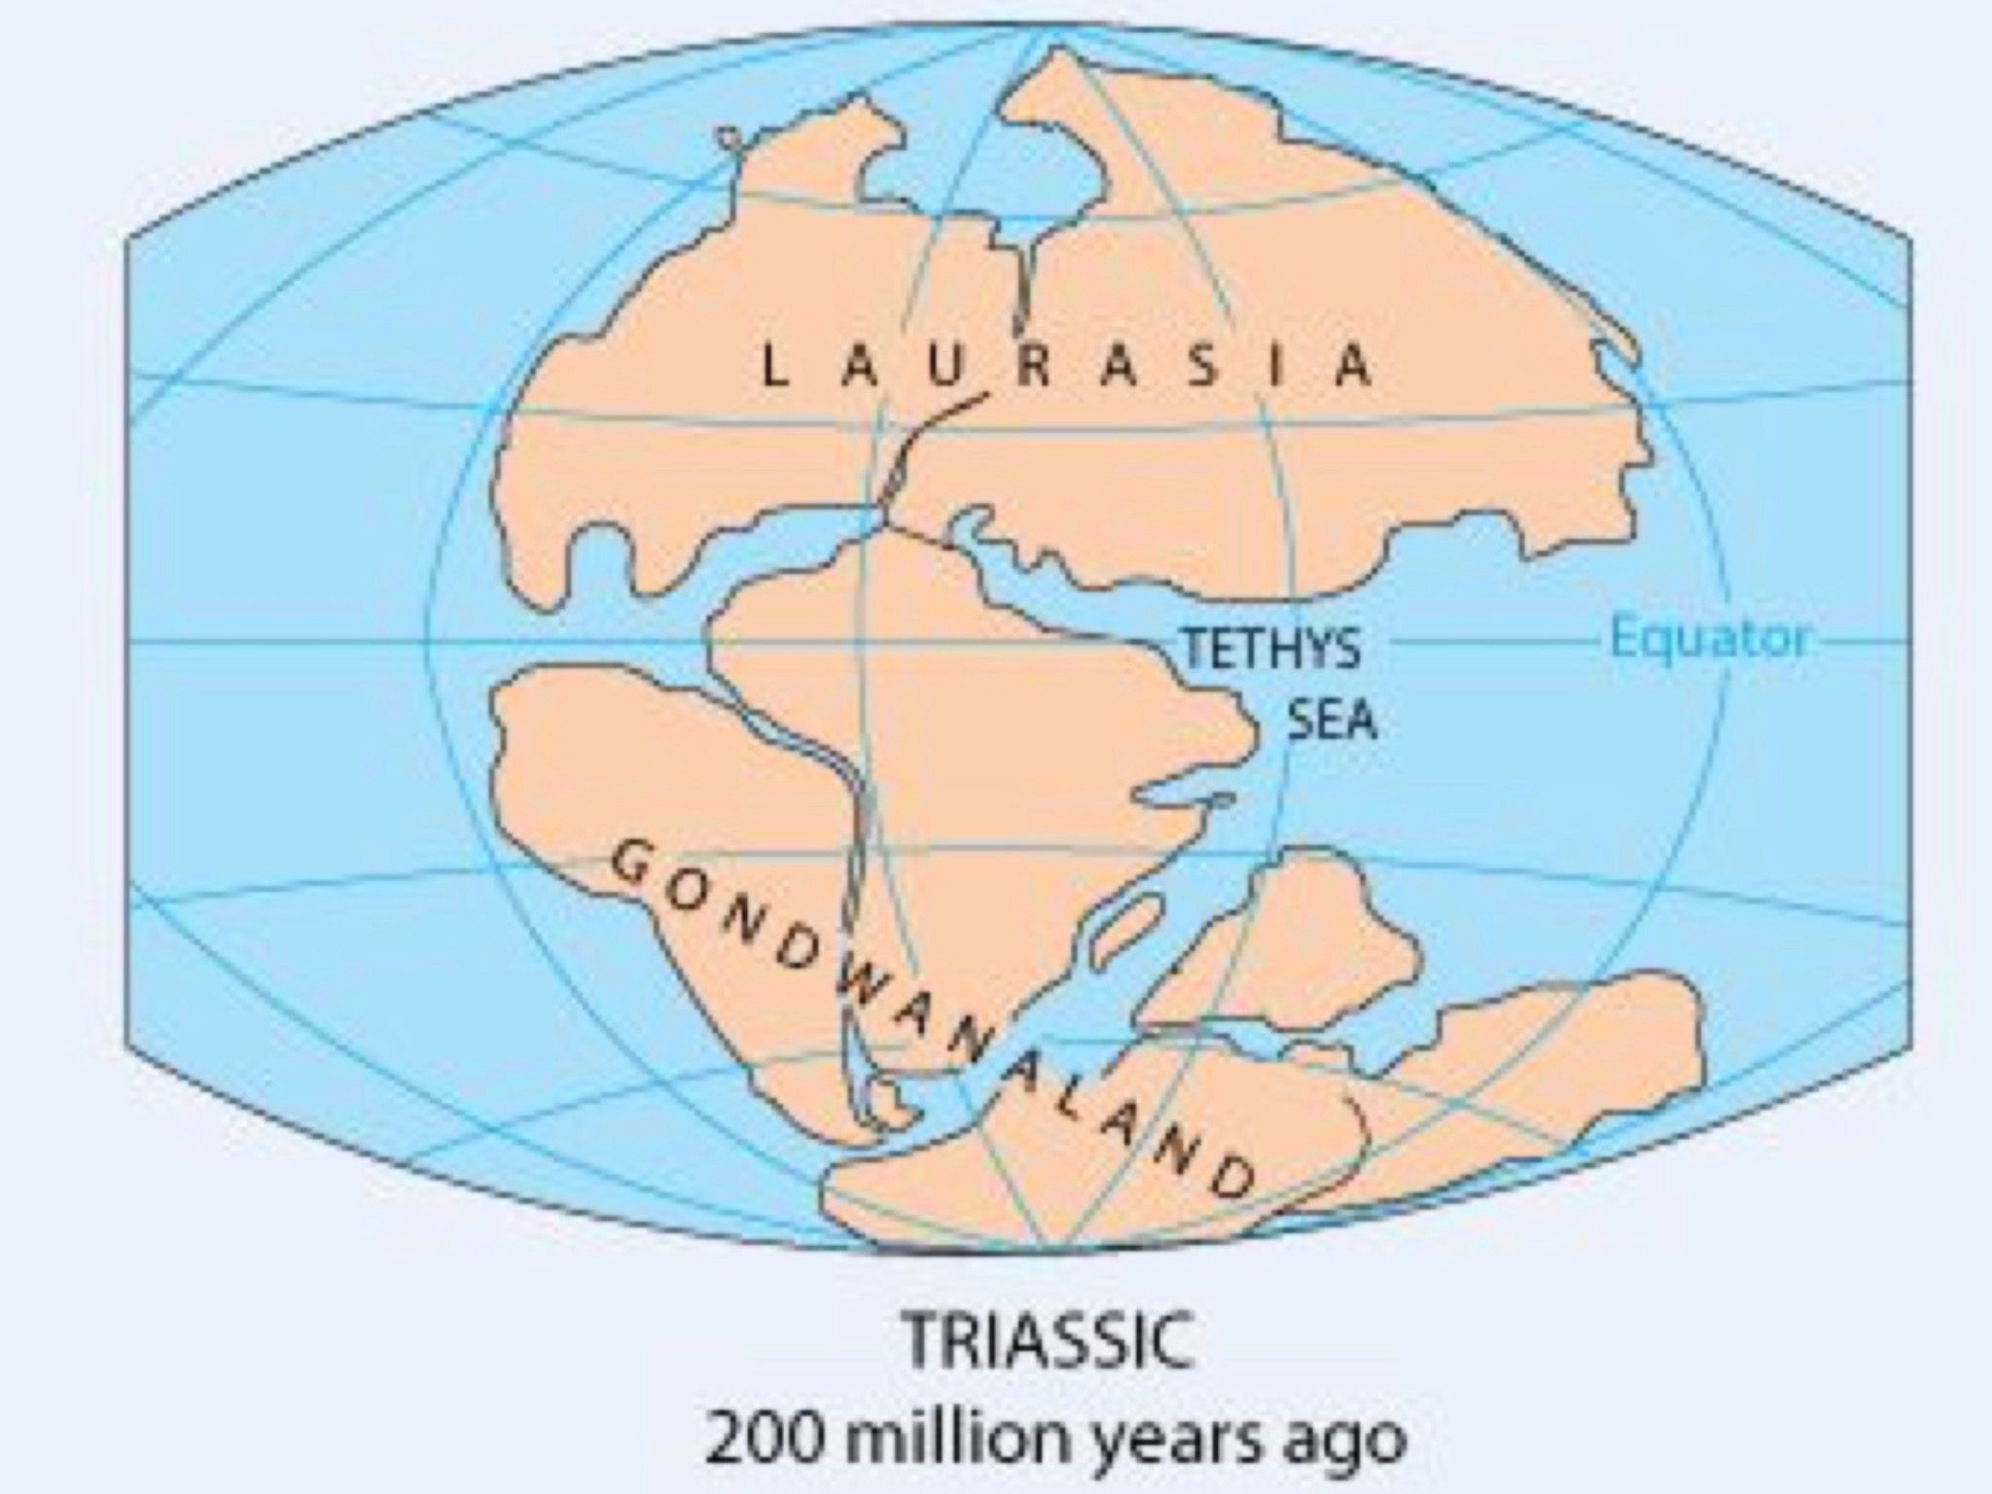
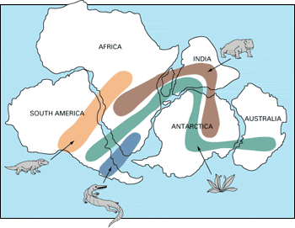
The parts that were sticking out above the ocean across history, Seuss called land bridges organisms could migrate without crossing oceans
He theorized about and named Gondwanaland connected by land bridges
Gondwanaland with land bridges

Slide 6
Scientists agreed (at the time) that land bridges used to exist, but sank into the ocean long agowhy we don’t see evidence of them now
Not everyone agreed with Seuss entire theory, but they were pretty sure that the Earth’s crust moved up and down and did not move much sideways (boy were they wrong!)

Slide 7
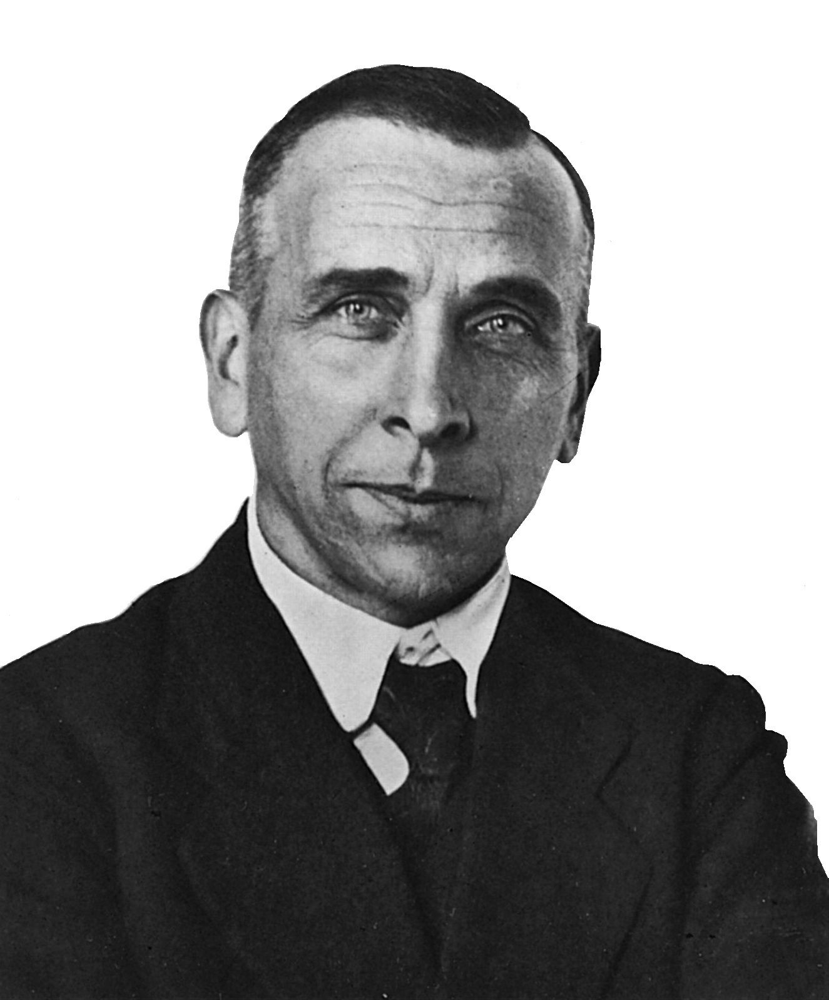
Alfred Wegner (1880-1930) proposed continental drift (recall what this theory is)
People thought he was “nuts” (yes, that is a scientific term and boy were they wrong!)

Slide 8
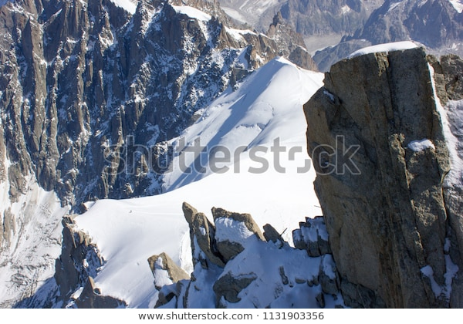
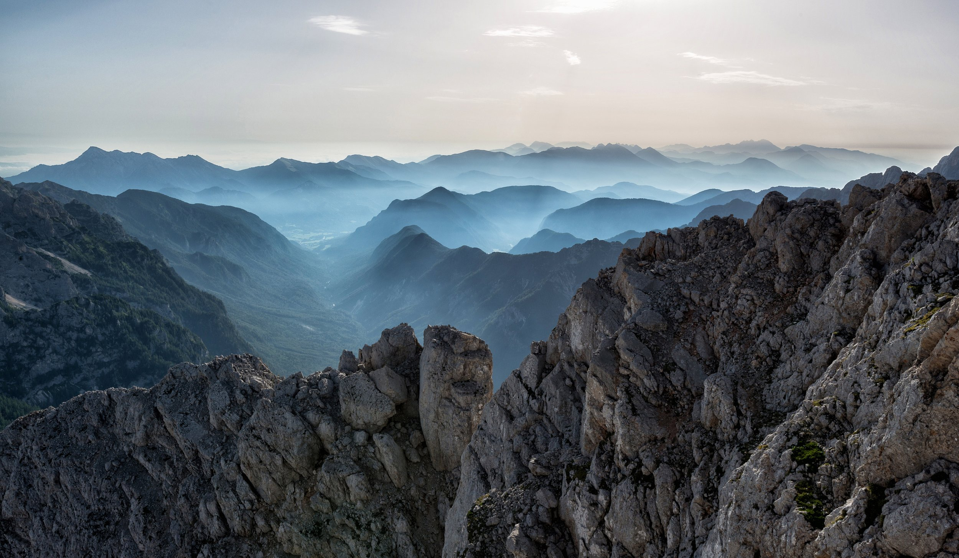
Problems proposed by Wegener with the contracting earth and land bridges theory
1. Alps appear to be pressed together horizontally
  Rock layers have folds that stack on top of each other horizontally  the distance of the mountains have shortened in a horizontal direction
The Alps

Slide 9
2. Contraction should produce uniform “wrinkles”
  Zones of folding were too specific and narrow (why do you think that the “wrinkles” are actually located where they are?)
  Radioactive decay was disoveredthe earth isn’t even cooling!

Slide 10
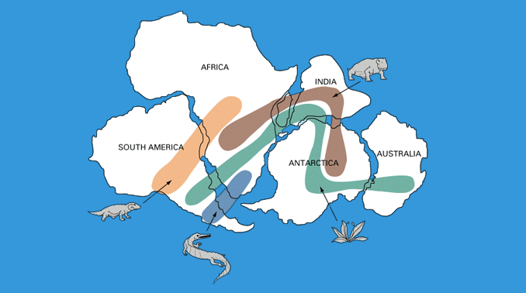
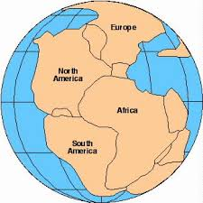
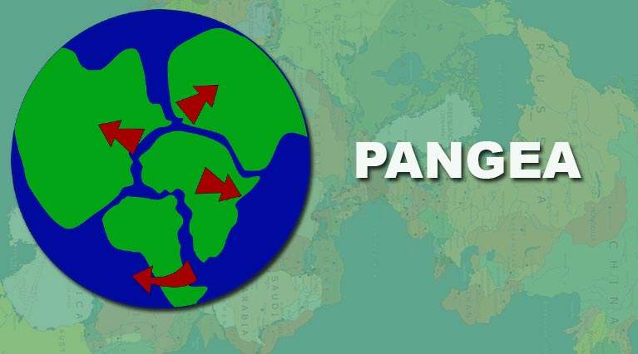
3. Wegner proposed Pangea which was caused by movement of the plates explained connected fossils on different continents without land bridges!

Slide 11
Ways Pangea and continental drift explain the evidence
  Mountains were formed at the edges of continents that moved away from each other when Pangea broke up (and did not need to be uniform)
  Explained the different ages of mountain ranges because Pangea broke up slowly and different parts split at different times
    How Mountains Are Formed

Slide 12
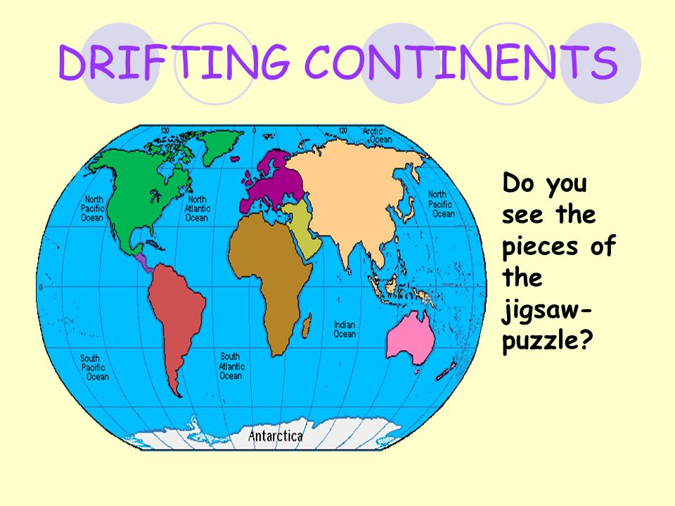

3. Explained the puzzle like fit of the continents
4. Explained the similarity of rocks, geologic structures and fossils especially on opposite sides of the Atlantic Ocean

Slide 13
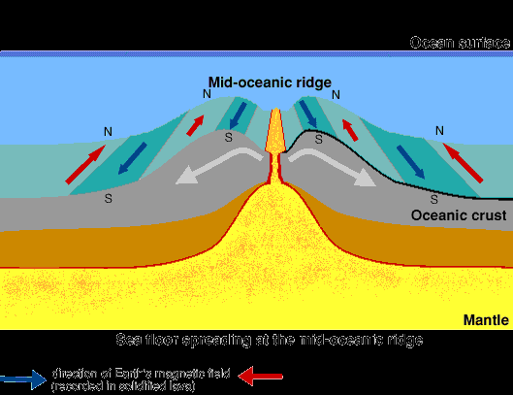
  5. Sea Floor Striping supported movements of the continents (Recall to your self what sea floor striping is and how it occurs)

Slide 14
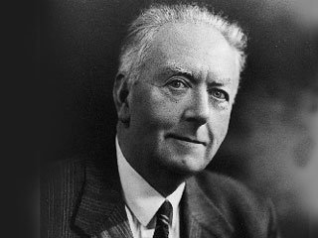
Wegener did not have an explanation about the mechanism behind how the continents moved.
Arthur Holmes (1890-1965) proposed convection currents

Slide 15
Wegener’s summation of how the geologic evidence fits together: “It is just as if we were to refit the torn pieces of a newspaper by matching their edges and then check whether the lines of print run smoothly across. If they do, there is nothing left to conclude but that th epieces were in fact joined this way. If only one line was available to test, we would still have found a high probability for the accuracy of fit, but if we have n number of lines, this probability is raised to the nth power.”

Slide 16
Scientists argued that continents could not “plow through” the sea floor (why is this an inaccurate characterization of what happened?)

Slide 17
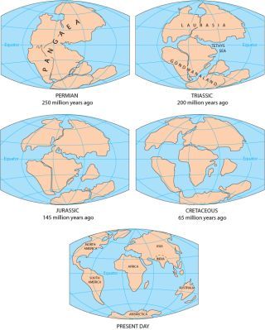
The stages of the break up of Pangea
The history and effects of Pangea (I am sorry for all the ads!)

Slide 18
Why must geologists rely on observations made of continental crust to reconstruct ancient supercontinents instead of oceanic crust?

Slide 19
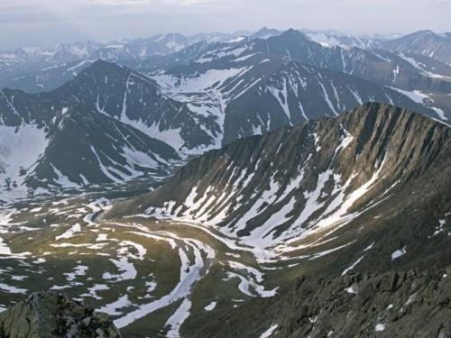
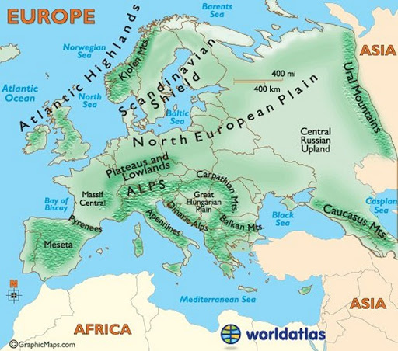
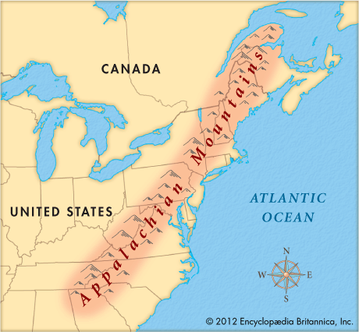
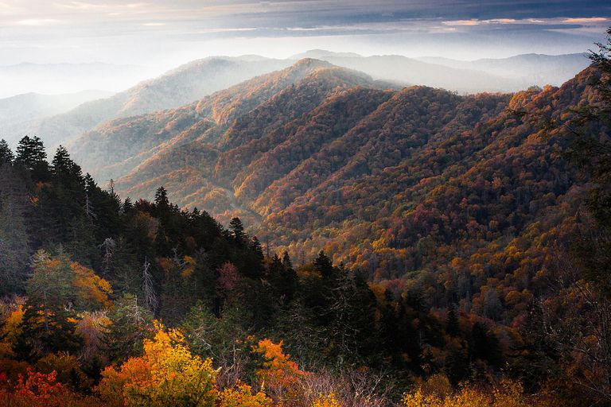
How supercontinents are reconstructed
  Matching up fossils
  Using ancient mountains to indicate former collision zones (such as the Appalachian and the Urals; the Urals are the oldest mountains on earth)
  Paleolatitude
The Ural Mountains
The Appalachian Mountains

Slide 20
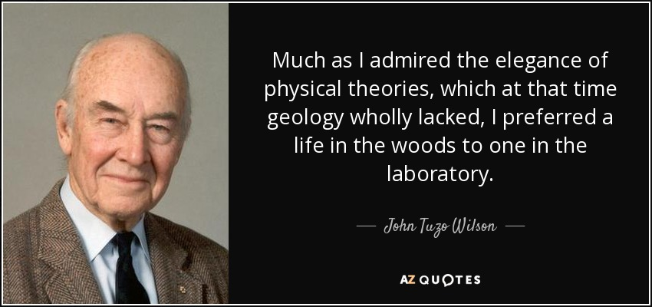
The Wilson Cycle: Geologists are best able to reconstruct Pangea, but they believe that the construction and deconstruction of supercontinents occurs in a cycle; named after John Tuzo Wilson (1908-1993)
Description of the Wilson Cycle
Video of The Wilson Cycle

Slide 21
Recall how paleomagnatism works.
Recall what we are able to learn from paleomagnatism.
Recall why we are able to identify paleolatitude, but not paleolongitude

Slide 22
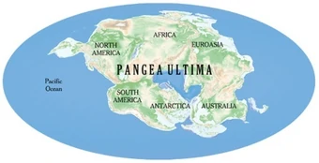
Please read p. 194-195 in the section provided and be able to identify predictions of results of continued movements of the plates
What is Pangea Ultima? How does it relate to the Wilson Cycle?

