Slide 1
Remember and be able to define the following plate boundary terms: divergent, convergent and transform

Slide 2
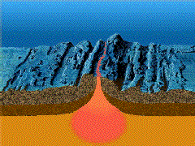
Divergent plate boundaries
  Mid-ocean ridges are divergent plate boundaries where mantle asthenosphere rises slowly upwards
click here to watch the animation in motion if it is not moving already

Slide 3
As the rocks rise, they begin to melt and form magma
  The melting temperature of rocks decreases as the pressure decreases
  The temperature of the rock stays about the same because it takes so long to cool, therefore as the pressure lessens, it melts more quickly

Slide 4
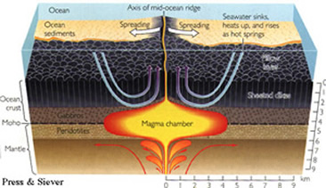
The rising melted magma from the asthenosphere creates underwater volcanoes all along the mid-ocean ridge
The 40,000 mile volcano

Slide 5
How new oceanic crust is formed:
The magma from underwater volcanoes is different than land volcanoes because the pressure from all of the water is great and has a cooling effect
  It oozes more like toothpaste than a liquid
  Some stays under the ground crystallizing there into new rock
  New rock moves away from the crest of the ridge = spreading ridges

Slide 6
Did you know that the Atlantic Ocean is getting bigger?
  a brief synopsis of why the Atlantic Ocean is getting bigger
  Newspaper article on why the Atlantic Ocean is getting bigger

Slide 7
Using the polarity of the earth the map the spreading of oceanic crust
The new crust formed is made of iron rich rock that is naturally magnetized
Most of these rocks have “normal polarity” and the north end of the rock’s “compass needle” points toward the Earth’s magnetic north
Some rocks have reverse polarity and they point towards the Earth’s magnetic south
continued

Slide 8
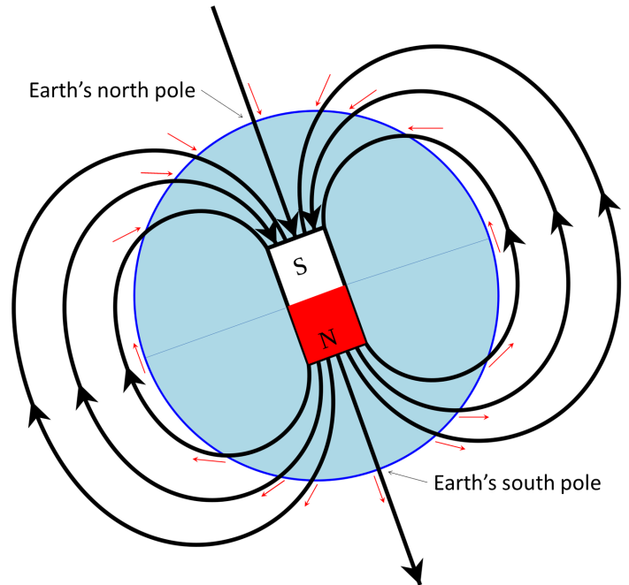

Slide 9
Because the sea floor is constantly spreading, magnetic striping of the polarized rocks form (see picture on next pane)
This is evidence that seafloor spreading occurs and demonstrates that the Earth’s polarity has changed over time.
Look especially at the magnetic striping and polar reversals section

Slide 10
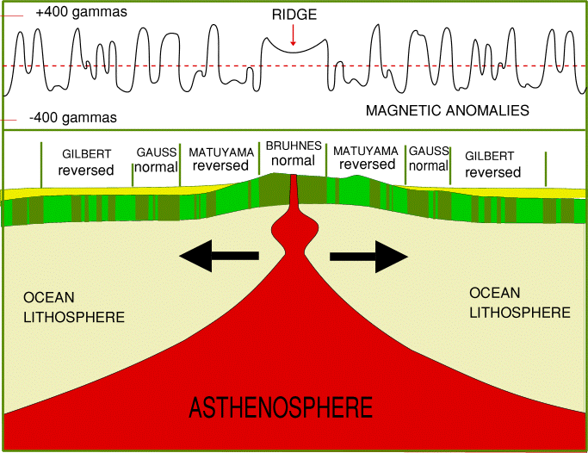
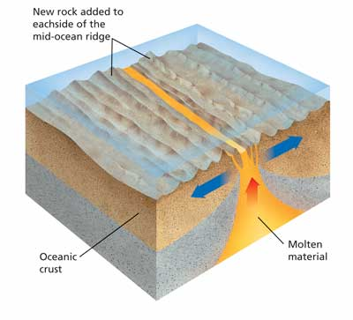
Plate Tectonics

Slide 11
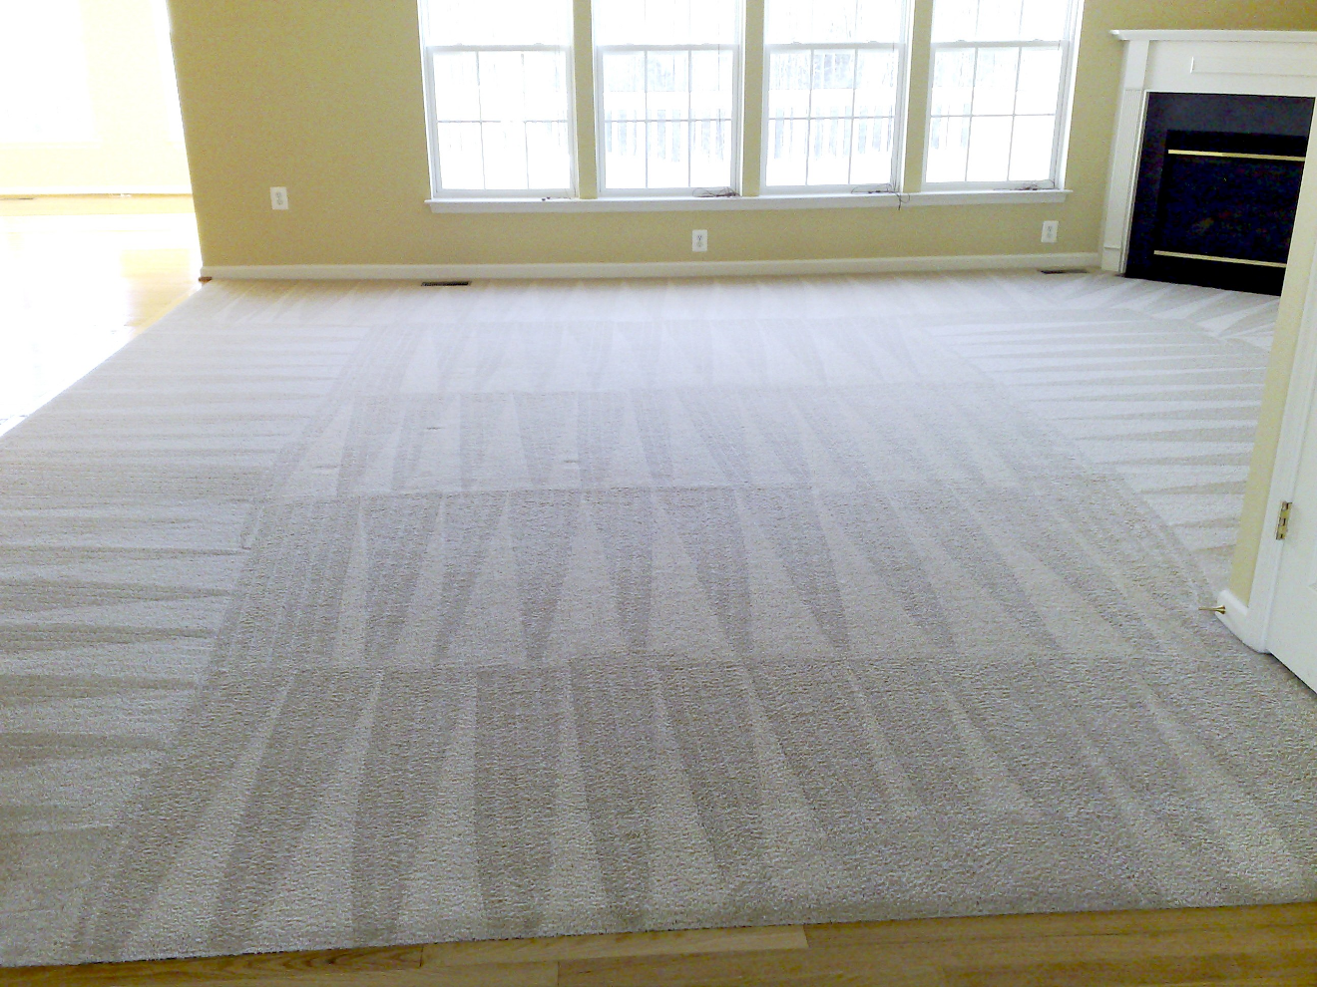
Seafloor striping is like the back and forth rows that a vacuum cleaner makes. It is the same rug with the same composition, but the individual fibers are facing a different way

Slide 12
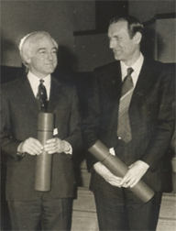
F. J. Vine and D.H. Matthews proposed the sea-floor spreading theory
Especially look at the section on seafloor spreading

Slide 13
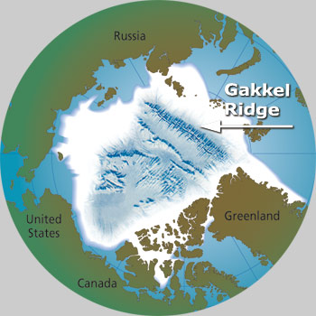
The Arctic Ridge has the slowest movement

Slide 14
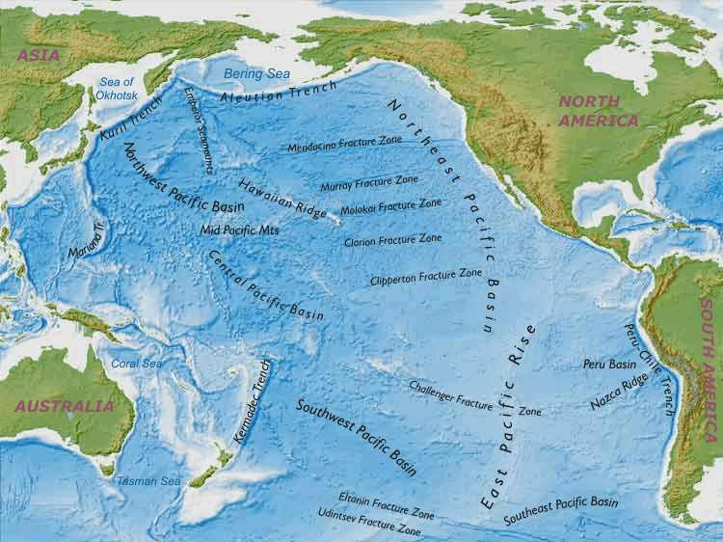
Plate Tectonics
The East Pacific Ridge is moving the fastest

Slide 15
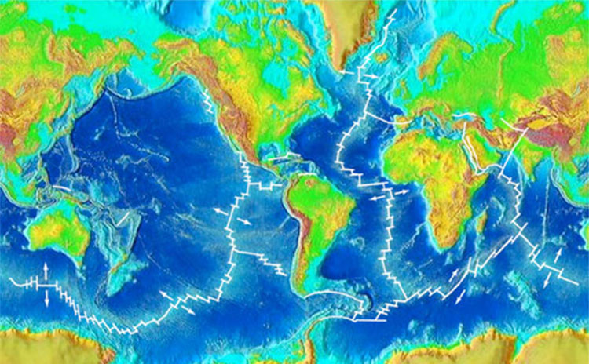
The mid-ocean ridge zig-zags across the entire globe in a continuous mountain range that is between 40,000-60,000 km long
Picture the seams on a baseball
What is the mid-ocean ridge
The nearly continuous, global Mid-Ocean Ridge system snakes across the Earth’s surface like the seam on a baseball. It is clearly visible on this map of global topography above and below sea level. The ridge system forms the longest and largest mountain range on Earth, winding its way between the continents.

Slide 16
The mid-ocean ridge is not straight. There are many perpendicular offsets
The offsets are parallel to the movement of the plates→scientists can figure out the direction of the movement of the plates
End of section 4

