Slide 1
Plate Tectonics
Section 1: Where are the Volcanoes and Earthquakes?

Slide 2
Plate Tectonics
Things to think about:
Evidence for movement and changes in the geosphere over time
The flow of matter and energy in the Earth
The nature of the Earth’s interior
How plate tectonics accounts for the features and processes that geoscientists observe in the Earth
How the theory of plate tectonics developed

Slide 3
Plate Tectonics
Plate Tectonics: The formation, movement and changes of the outer layer of the earth.

Slide 4
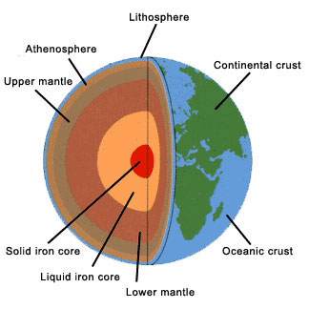
Layers of the Earth

Slide 5
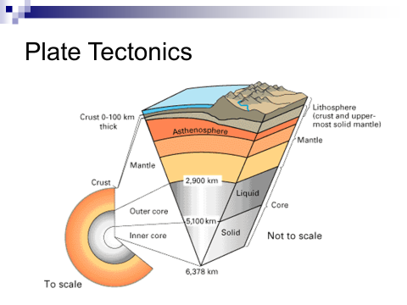
Plate Tectonics
The interior structure of the earth
  Crust: The thin outermost layer of the earth

Slide 6

  Continental crust-old
  Oceanic crust-new and thinner

Slide 7
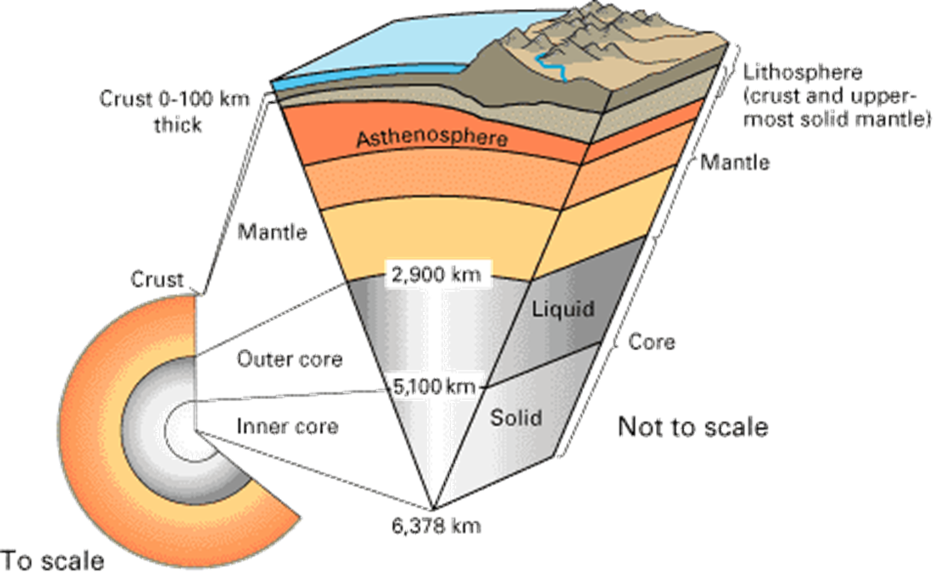
Mantle-layer beneath the crust with two parts
  Lithosphere-Crust and upper part of the mantle
  Asthenosphere: The deeper part of the mantle that moves like a stiff liquid

Slide 8
Plate Tectonics
The lithosphere part of the mantle is different in composition from the crust, but moves in the same way
The asthenosphere is the same in composition as the crust, but different in how they move

Slide 9
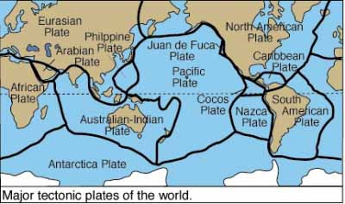
Lithospheric plate: gigantic slabs that move in relation to each other-3 types of movement

Slide 10
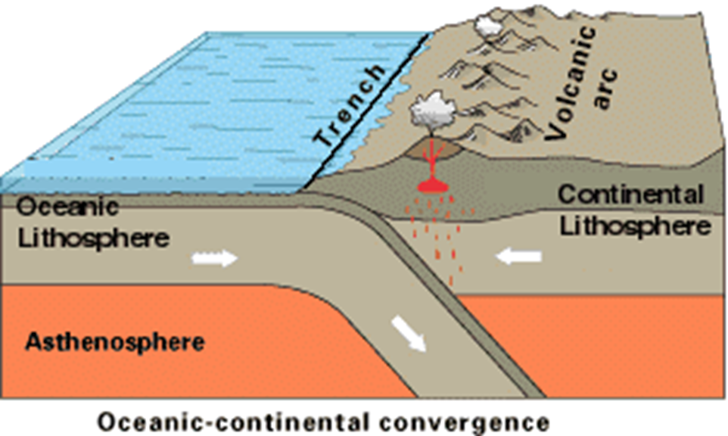
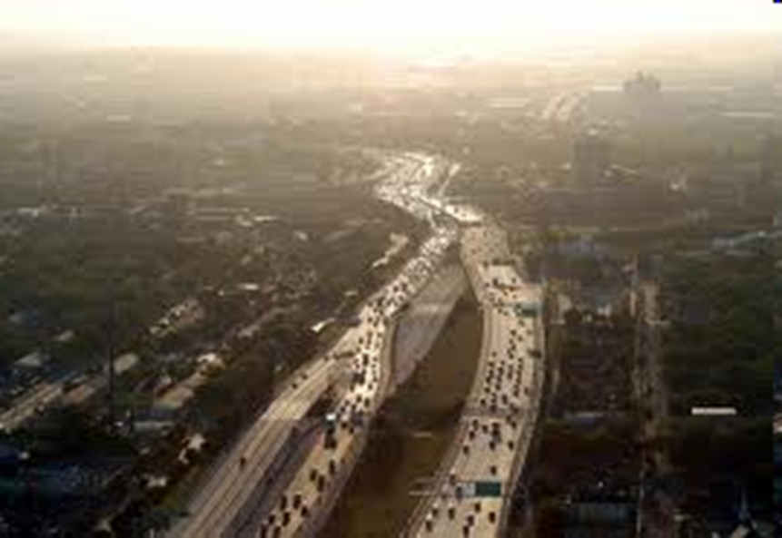
Types of plate boundaries
Convergent plate or collision boundaries: 2 or more lithospheric plates move towards each other and collide
description of the 3 types of convergent plate boundaries and what happens at each
Pictures of the boundaries

Slide 11
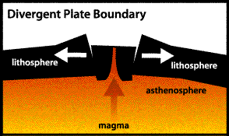
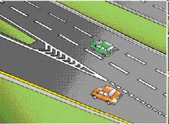
2. Divergent plates: move away from each other

Slide 12
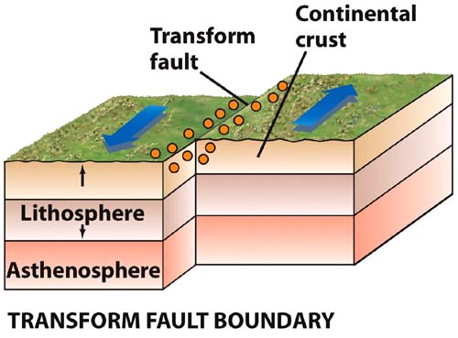
3. Transform boundary: Plates are moving parallel to each other
Pictures and descriptions of all the plate boundary types

Slide 13
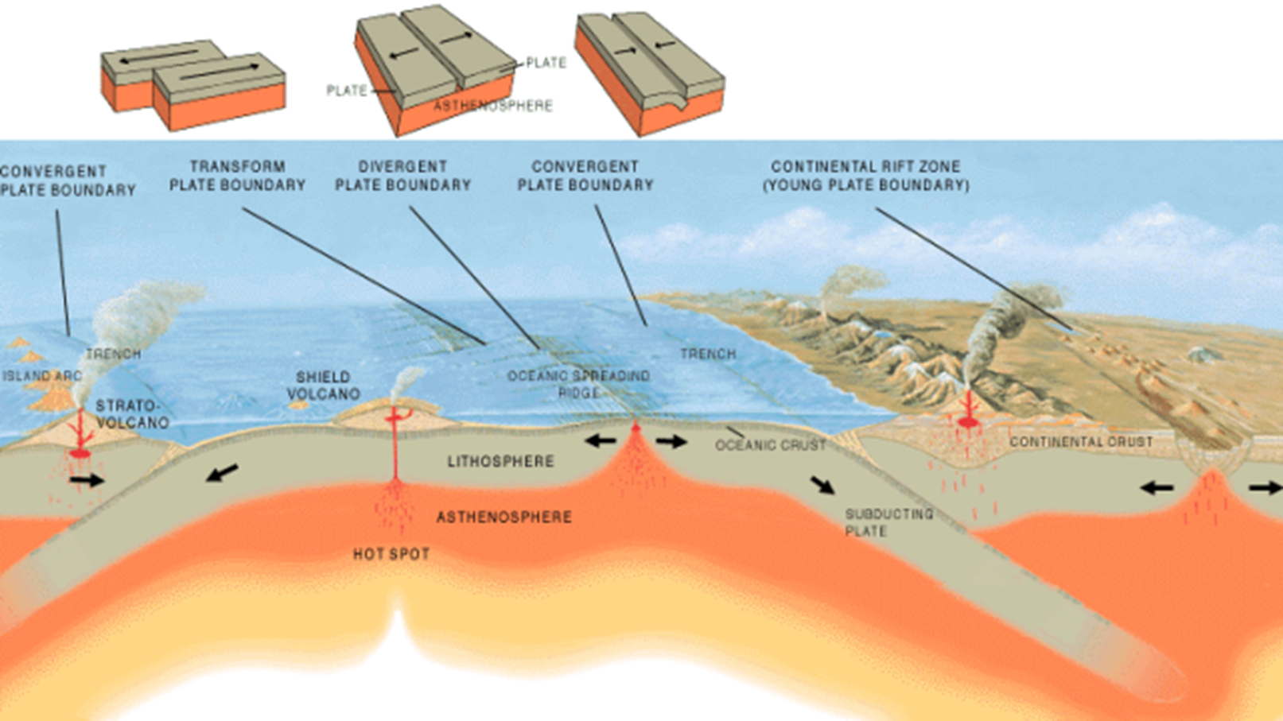
Summarizes all three plate boundaries

Slide 14
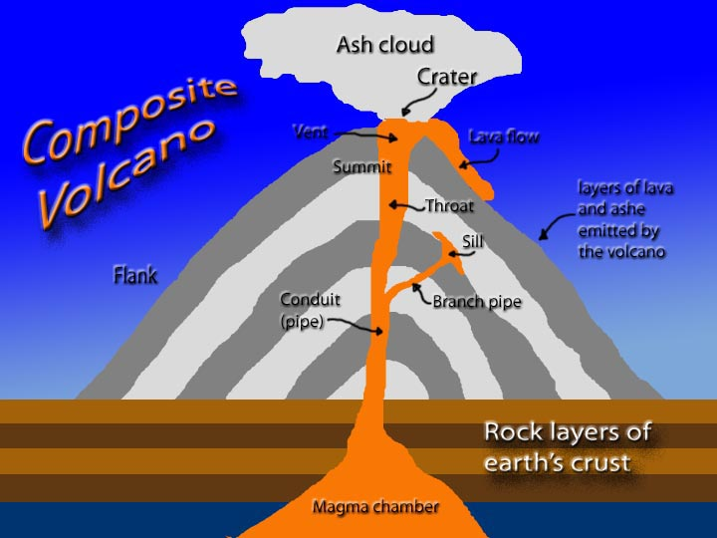
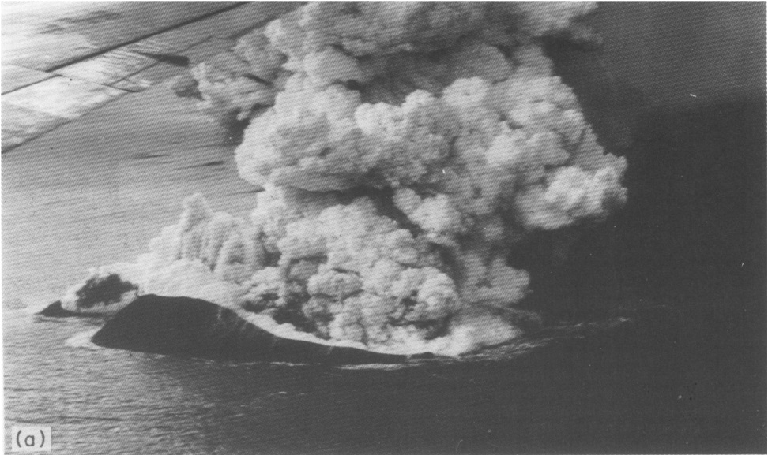
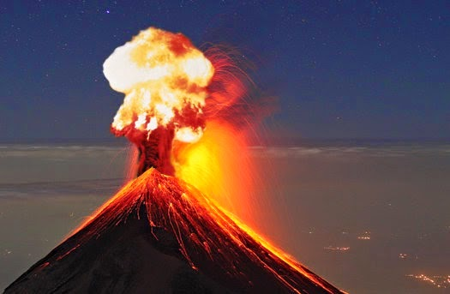
Volcano: vent or fissure in Earth’s crust that allows magma, gases, and ash to escape from below the surface

Slide 15
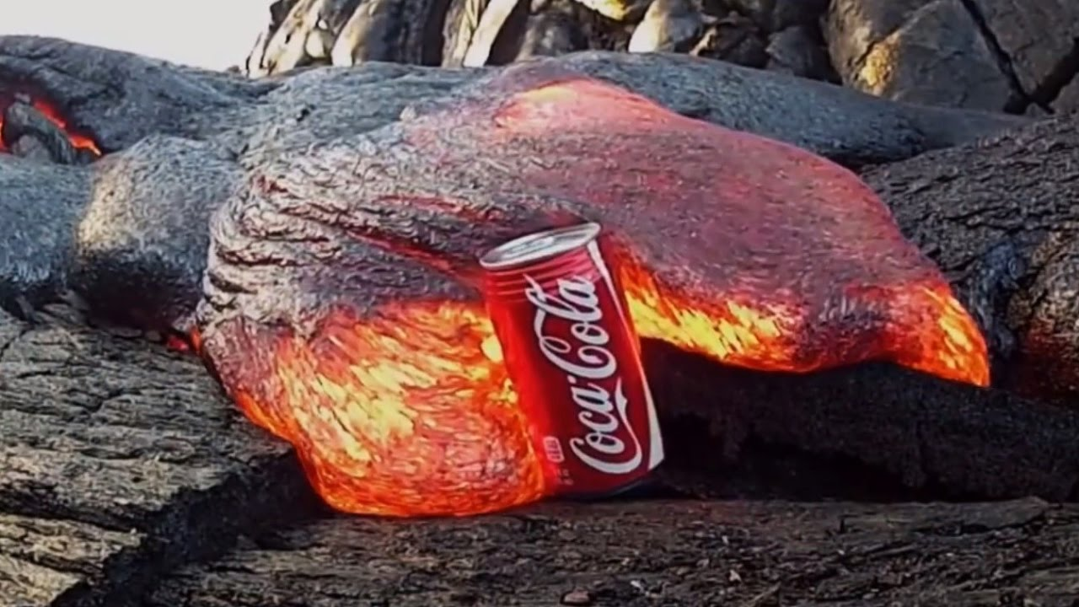
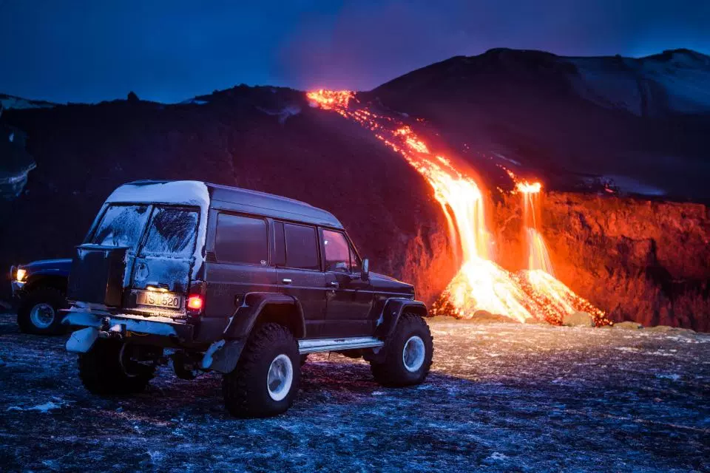
Magma: molten rock material generated within Earth
Lava: magma once it
Has exited the volcano

Slide 16
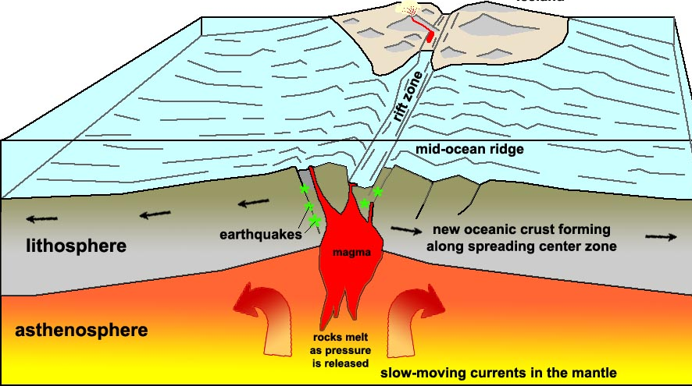
Mid-ocean ridge: a continuous mountain range extending through all Of Earth’s ocean basins
Pearson text book description of a mid-ocean ridge
NOAA description of a mid-ocean ridge and rift valley

Slide 17
Rift Valley: A crest of the mid-ocean ridge where magma from deep in Earth rises up into to form rift valley to form volcanoes
  Occurs at divergent plate boundaries which causes the valley and allows material from deeper in the Earth to surface
  Videos, pictures and explanations of rift valleys

Slide 18
Volcanoes are more common under water
Volcanoes, earthquakes and islands are found in limited areas on the surface which are determined by the location of boundaries between the tectonic plates

Slide 19
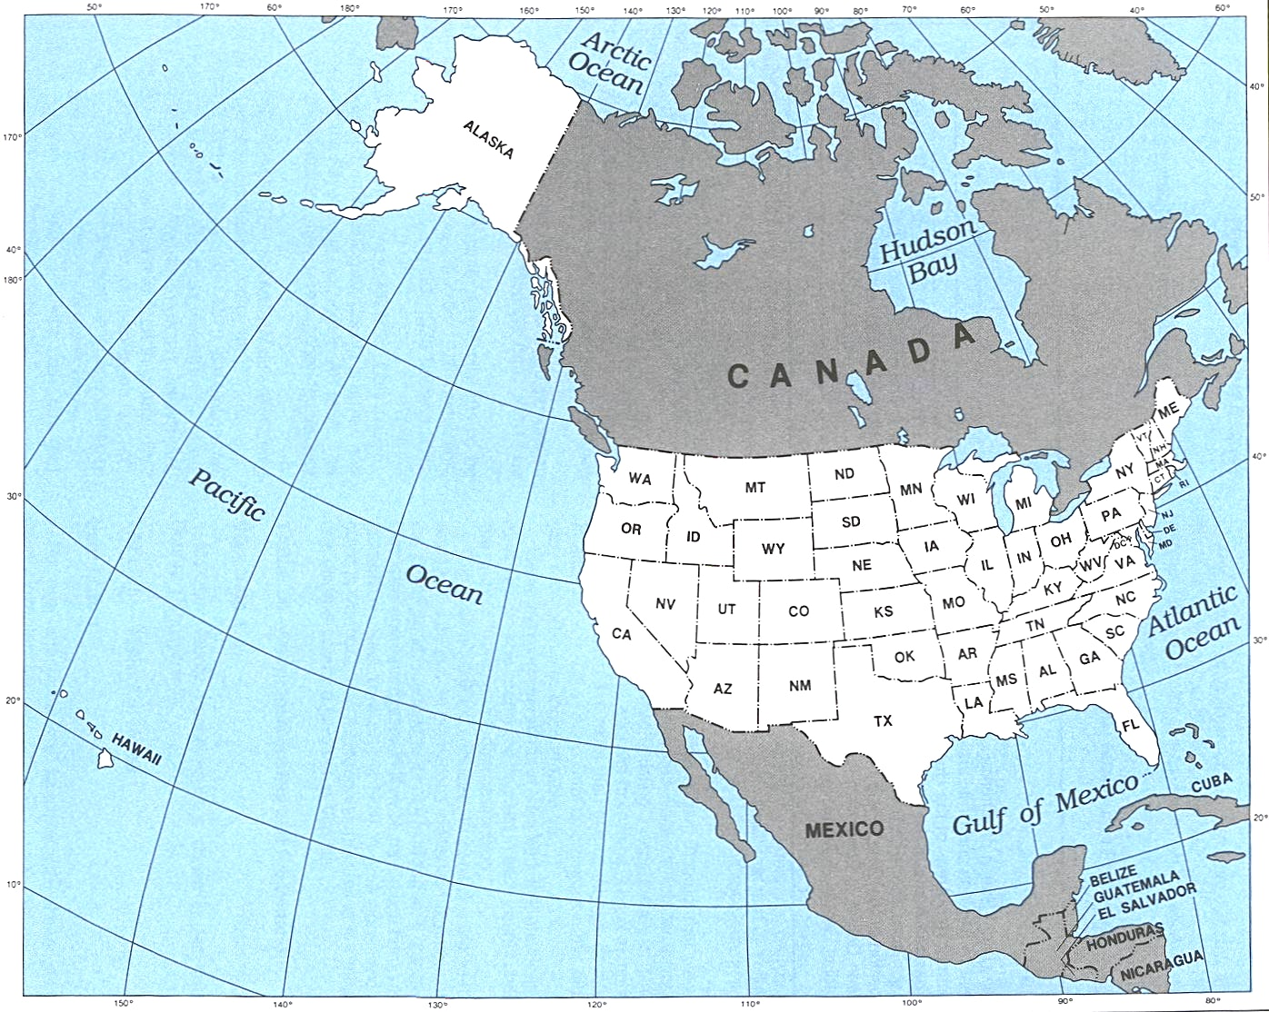
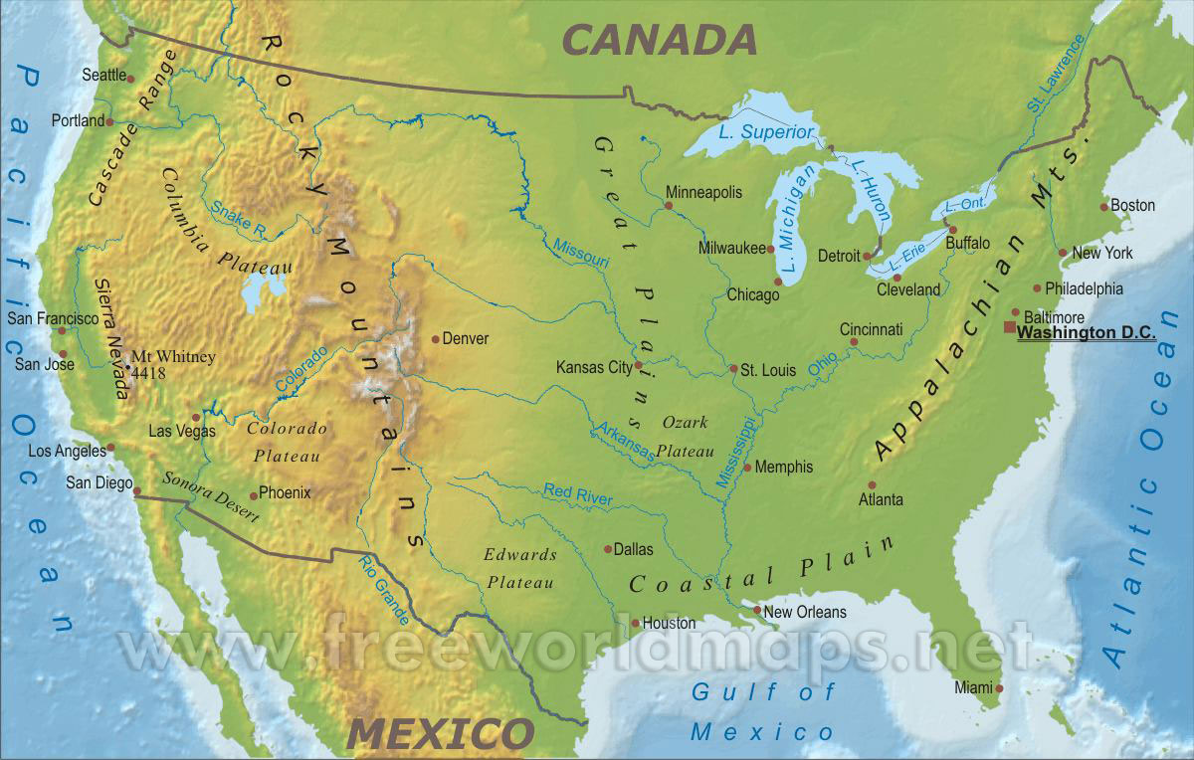
Examples of the result of tectonic activity on the western edge of the United States include the Cascade Mountain Range and the Hawaiian and Aleutian Islands. Notice the arc of the Hawaiian and Aleutian Islands.
Aleutian Islands

Slide 20
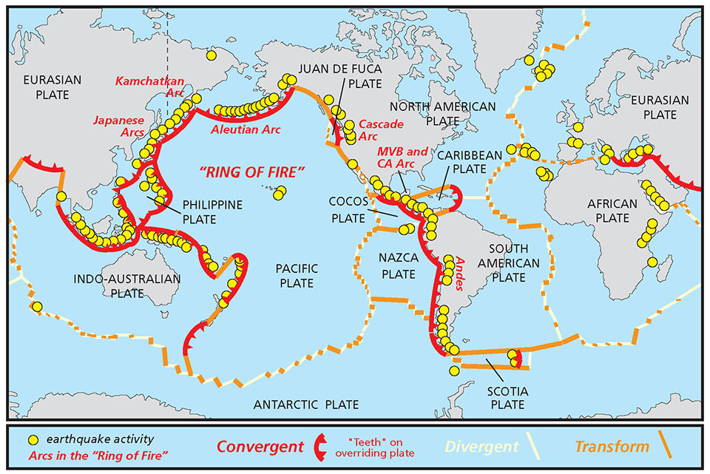
The Ring of Fire: A circular formation of volcanoes that are the best known and most concentrated
More information on the ring of fire
Because I know that it is probably already going through your head anyway...

Slide 21
Hot spot: a fixed source of abundant rising magma that forms a volcanic center that has persisted for tens of millions of years
Seamount: an elevation of the seafloor, 1000m or higher, either flat-topped or peaked

Slide 22
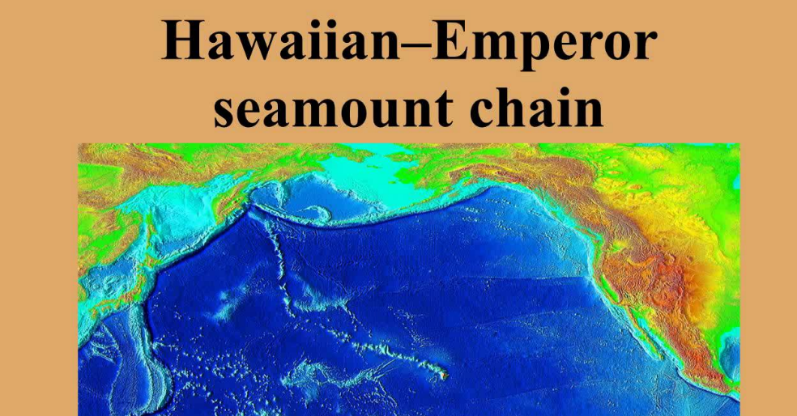
The Hawaiian Islands and the Emperor Seamounts were formed by the same hot spot. What can we learn from their shape?
Formation of the Hawaiian islands
USGS information on how the Hawaiian islands were formed
Information on how the Hawaiian Islands, Aleutian Islands and Emperor Seamounts were formed

Slide 23
Earthquake: a sudden motion or shaking of Earth as rocks break along an extensive surface within Earth
  Around the surface of the Earth, where do you think earthquakes will most often be found?
  What is causing them?
What causes an earthquake-ask an Earth scientist
Where do Earthquakes occur and why-British Geological Survey

Slide 24
Earthquake (seismic) waves: a general term for all elastic waves in Earth produced by earthquakes or generated artificially by explosions (we will be connecting this to a fracking paper later in the semester)
Movement of the earth’s crust causes the seismic waves
Earthquakes usually occur at some depth below the surface of the Earth

Slide 25
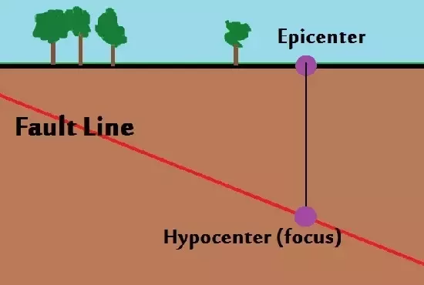
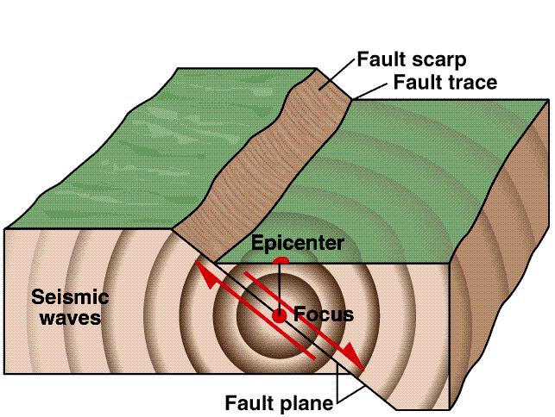

Earthquake focus (foci): The place in the Earth where rupture of the ground occurs (usually below the surface of the Earth)
Epicenter: The geographic point on Earth’s surface directly above the focus

